Slide 1
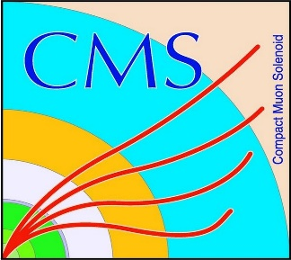

HEP Weekly Report
George Bakas
NTUA

Slide 2
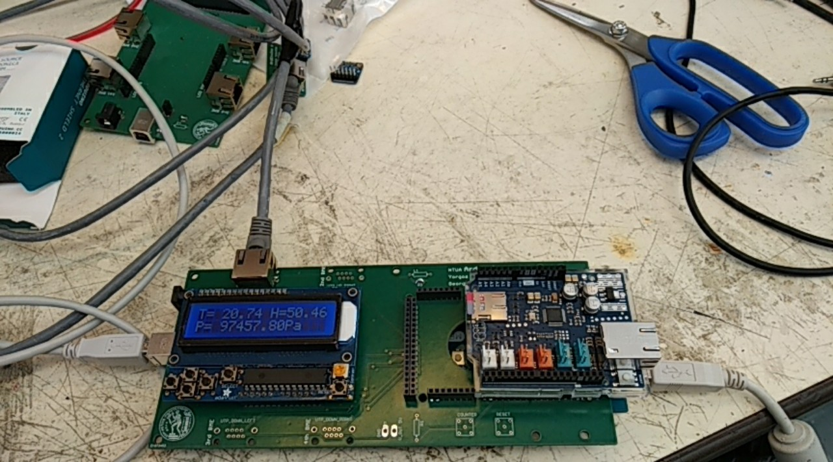
Weekly Progress
ArdEnvino:
Received new PCB’s
Soldered PCB
Communication with sensors, screen etc seems ok
Connection between Arduino Mega and Ethernet Shield is now possible…

Slide 3
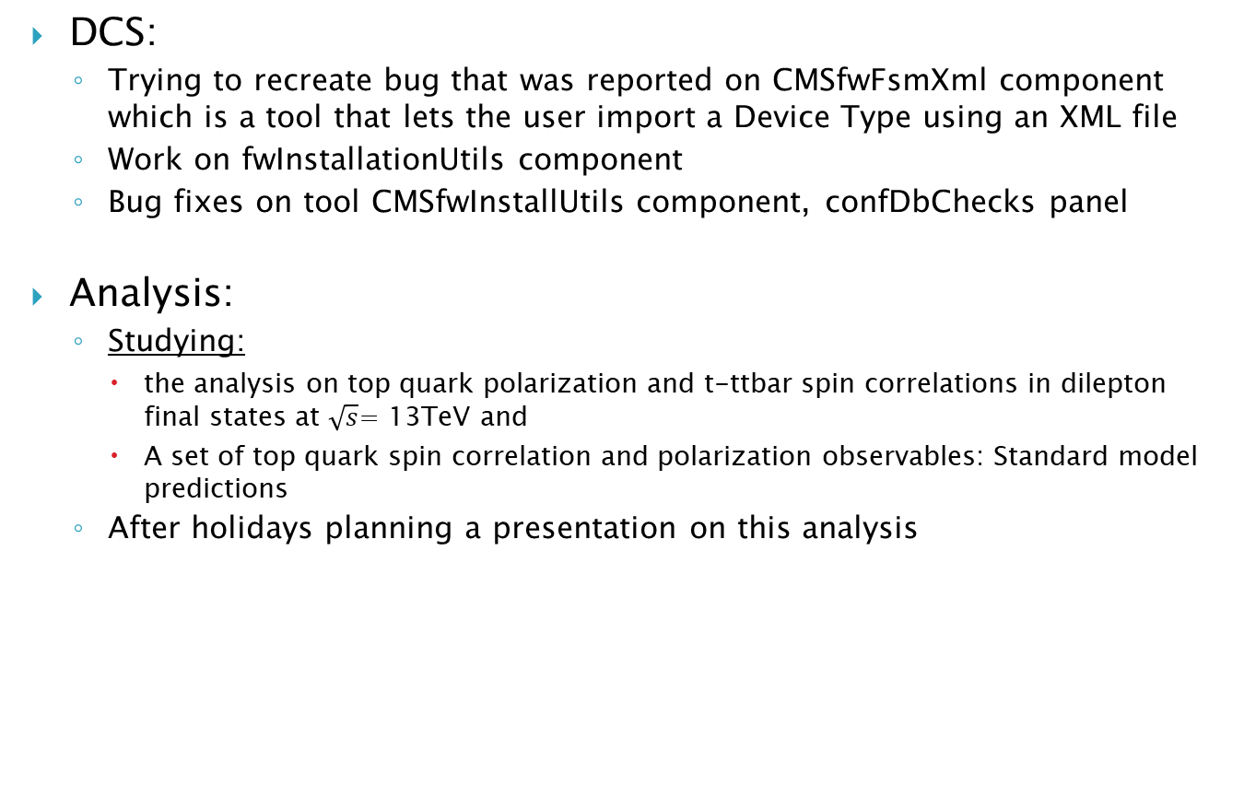
Weekly Progress
DCS:
Trying to recreate bug that was reported on CMSfwFsmXml component which is a tool that lets the user import a Device Type using an XML file
Work on fwInstallationUtils component
Bug fixes on tool CMSfwInstallUtils component, confDbChecks panel
Analysis:
Studying:
the analysis on top quark polarization and t-ttbar spin correlations in dilepton final states at $\sqrt{s}$= 13TeV and
A set of top quark spin correlation and polarization observables: Standard model predictions
After holidays planning a presentation on this analysis

